Slide 1
Accurate and Scalable Cross-Architecture Cross-OS Binary Code Search with Emulation
Joint work with Zhengzhi Xu, Mahinthan Chandramohan, Yang Liu
Nanyang Technological University.
Oct. 04, 2017.

Slide 2

Motivation
What are software clones?
Research trend: from the source code clones to binary code clones
Security concerns of buggy clones
The vision of reusing code repository (e.g., code tagging)

Slide 3
Existing Work
Using Syntax and structures: BinDiff, BinHunt, BinSlayer, Tracelet.
Using Low-level Program Semantics: originating from black-box testing. BLEX
Using High-level Program Semantics:
similar to malware detection to some extent. BLEX, MockingBird

Slide 4
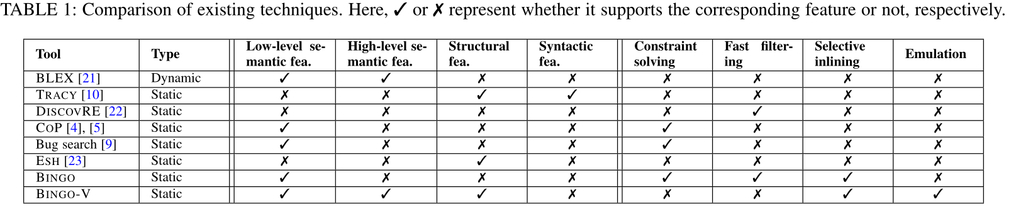
Problem with Existing Tools
Not optimized for cross-arch, cross-OS matching
Runs only in Linux
Has FP only using low level semantic features
Not scalable (e.g., using symbolic execution)

Slide 5
Challenges for Semantics-based Matching
C1: The trade-off challenge of deciding the granularity of function model.
C2. The accuracy challenge of using low-level semantic features.
C3. The performance challenge of using static symbolic analysis or dynamic execution.

Slide 6
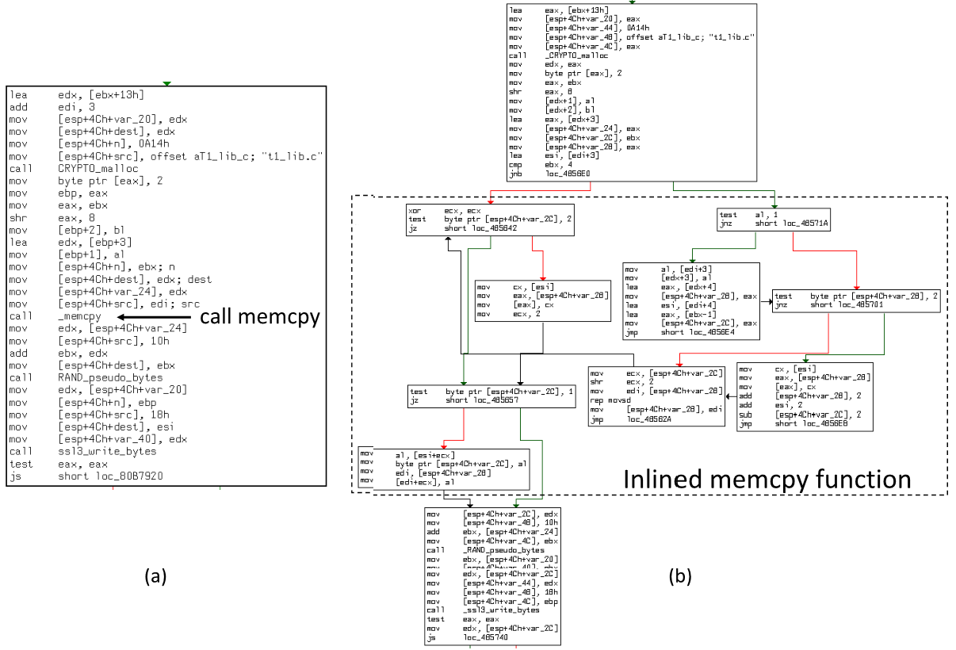
Motivation Example (1)
C1. The trade-off challenge of deciding the granularity of function model.

Slide 7
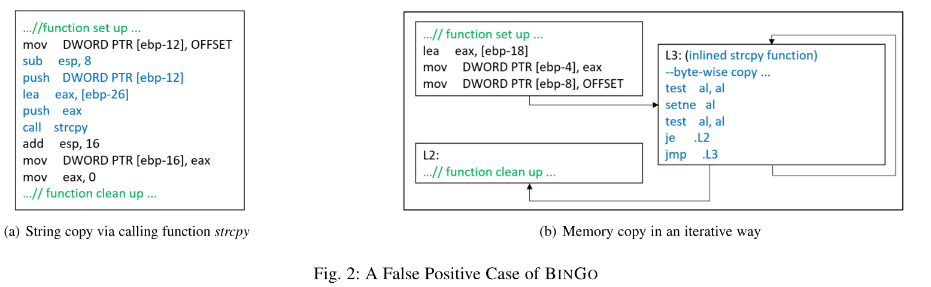
Motivation Example (2)
C2. The accuracy challenge of using low-level semantic features.

Slide 8
Conclusion from Examples
Structural features are BB-oriented, and suffer from FN cases --- compilation options change BB structures
Low-level semantic features are I/O-oriented, and suffer from FP cases --- I/O samples for test cases cannot be complete.

Slide 9
Key Contribution
Our work is the first attempt to incorporate emulation.
extract structural features based on the idea of centroid based clone detection.
evaluate our approach under the scenarios of cross-architecture matching, cross-OS matching, and cross-compiler matching.
compare Bingo-E with the available state-of-the-art tools of binary code search in terms of search accuracy and performance.

Slide 10
Solution Summary
S1: Flexible function model via k-tracelet and 3D-CFG.
S2: Completing function semantics via selective inlining and identifying the high-level semantics.
S3: Efficient semantics extraction via binary code emulation.

Slide 11
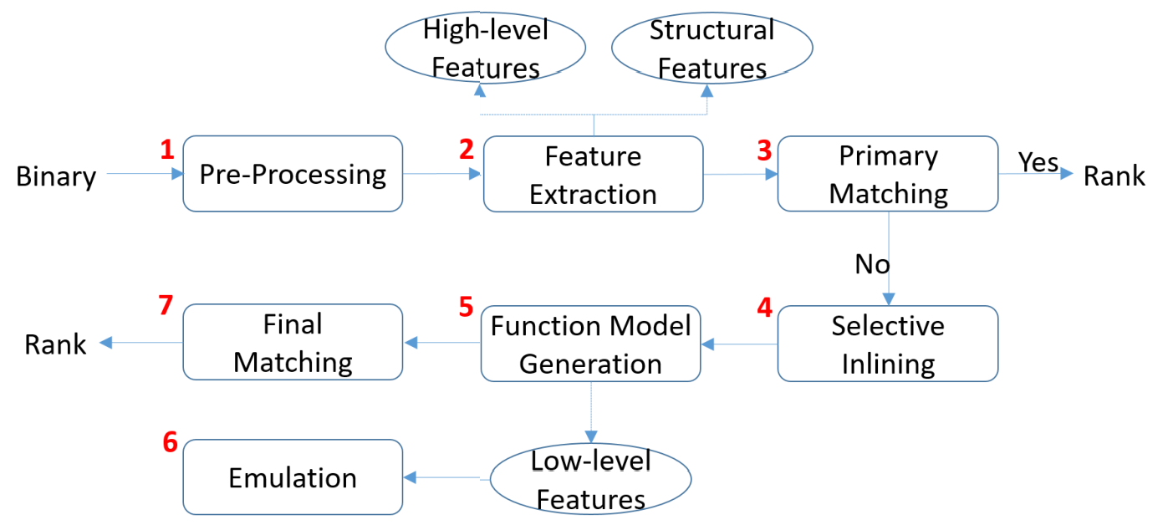
BinGo-E Architecture
Notes:
We explain how each step in our approach works in brief. At step 1, given a signature function, it performs the preprocessing, i.e., disassembling and building the CFG for the signature function. At step 2, we extract these features from the high-level semantics and structure information in Table 2. As shown in Table 2, we extract 6 types of high-level semantic features (§4.2) and 3D-CFG structural features (§4.1). At step 3, a primary matching step is conducted to measure the similarity based on the Jaccard distance of high-level semantic features and the centroid distance of structural features (§6.1). If no results are above the similarity threshold, the process proceeds with comparing low-level semantic features (§6.2). At step 4, for each function in the target binaries, function calls are identified and selectively inlined according to the relevance of called libraries and other user-defined functions (§5). Note that selective inlining is for addressing C2 (§2.3). Selective inlining is
transitive. Assume function a calls function b and b calls function c. If a selectively inlines b, then the decision of inlining c into b is according to Algorithm 1 (§5). If a does not need to inline b, then it is certainly unnecessary to inline c into b. At step 5, for the signature functions, length variant partial traces (up to k-tracelets) are generated and grouped to form the function models (§6.2.1), which low-level semantic features are extracted from (§6.2.2). Note that function model generation and feature extraction is a onetime job. At step 6, we rely on emulation to get the input/output values, flags, memory addresses of signature functions as low-level semantic features (§4.3.3). Finally, at step 7, combining Jaccard Distance for low-level semantic features and results of the primary matching, BINGO-E returns target functions that are above the similarity threshold in a ranked order (§6.3).

Slide 12
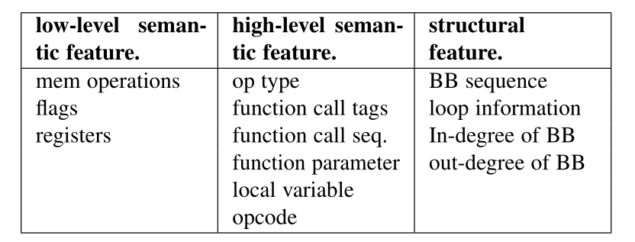
Feature Extraction
Structural features
High-level semantic features
Low-level semantic features (e.g., Emulation)

Slide 13
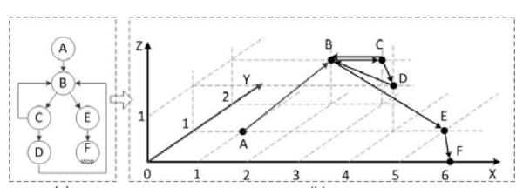
Structural Features
3D-CFG [ICSE 2013] depicts the CFG structure of a function at a high-abstraction level.
Each node has unique coordinates, denoted as a 3-tuple (x,y,z), where x is its sequential number in the CFG; y is the number of its outgoing edges (out-degree of the node in CFG), and z is the loop depth of the node.

Slide 14
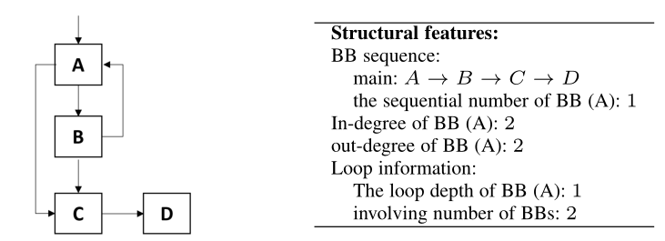
Structural Features Contd.
Basic-block sequence
Loop information
In-degree info of basic-blocks
Out-degree info of basic-blocks

Slide 15
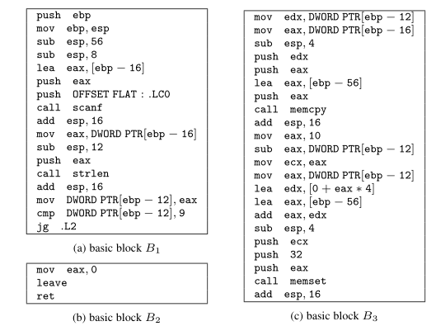
High-level Features
Instruction operation type
Function call tags
Function call sequence
Function parameter info
Function local variable info

Slide 16
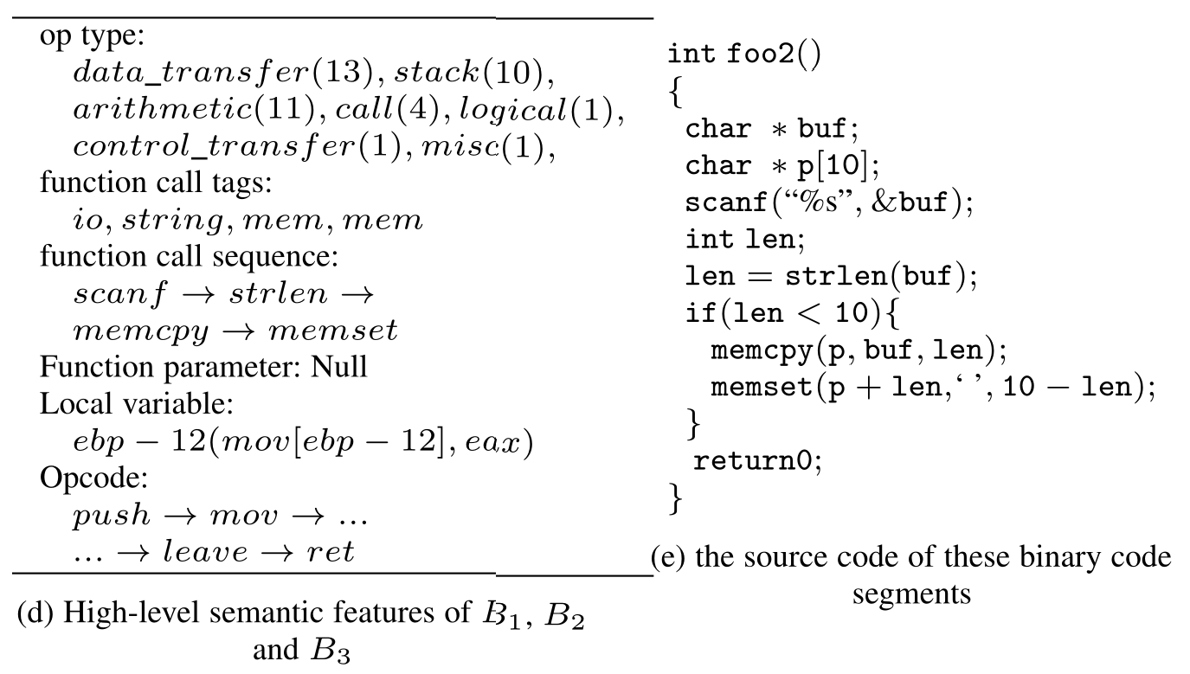
High-level Features

Slide 17
Low-level Features
1. Features originally used in Bingo: Flags values
2. Newly added low level semantic features;
Values read from the program heap (denoted as “v1”)
Values written to the program heap (denoted as “v2”)
Values read from the program stack (denoted as “v3”)
Values written to the program stack (denoted as “v4”)

Slide 18
Selective Inlining (1)
Inlining is a technique in compilers to optimize the binaries for maximum speed or minimum size
Our strategy has a different goal in contrast with compilation process — ours is for program semantics recovery, while compilers’ is for speed or size optimization.

Slide 19
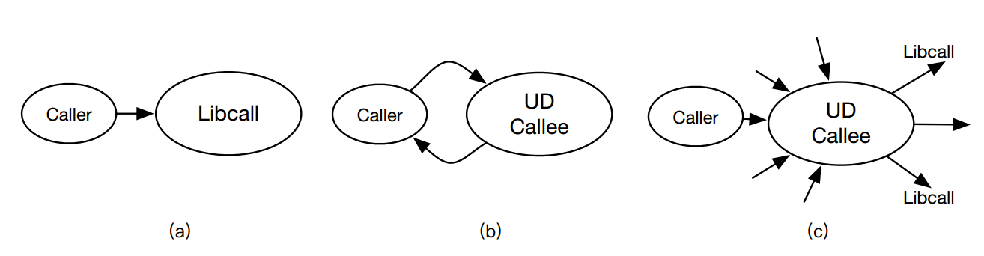

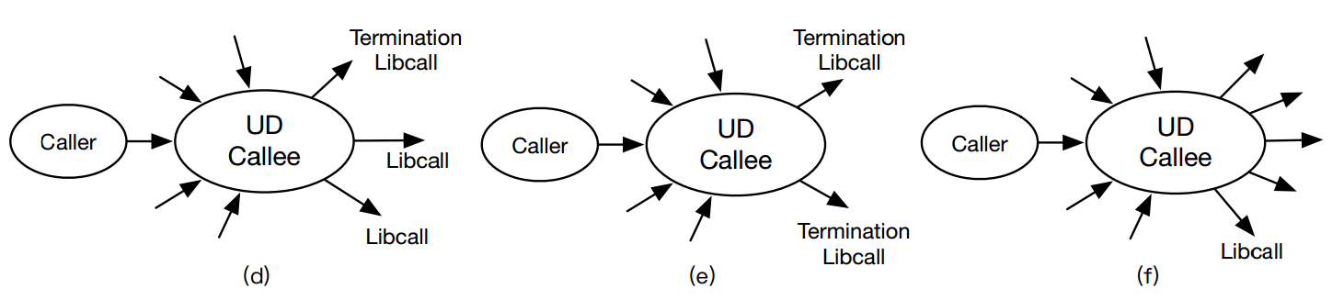

Selective Inlining (2)

Slide 20
Emulation
Given input code in binary form:
Decode binary into separate instructions
Emulate exactly what each instruction does:
Instruction-Set-Architecture manual referenced is needed
Handle memory access & I/O upon requested
Update CPU context (registers/memory/etc) after each step
Example:
Instruction to emulate: ‘push eax’
load eax register
copy eax value to stack bottom
decrease esp by 4, and update esp

Slide 21
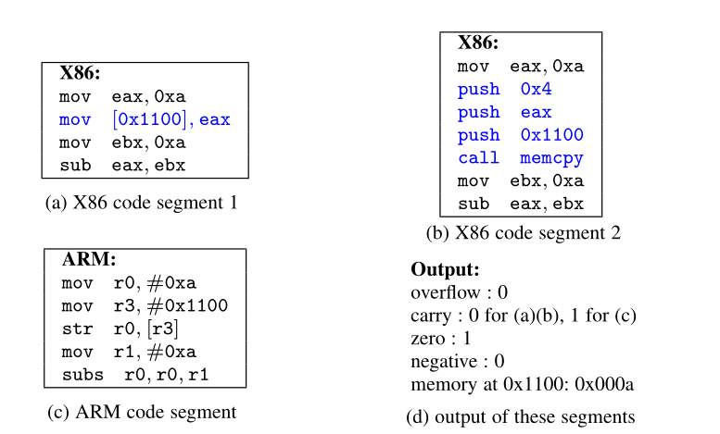
Emulation: example

Slide 22
Emulation Contd.
Key features in our Implementation
Capability to set-up stack frame
Capability to set-up heap
Capability to set-up memory segments
Global Vs. Local machine state (e.g., memory)
Persistent Vs. Non persistent memory access
Stack frame analysis
Local (i.e., stack) memory access pattern (e.g., local array)
Global (i.e., heap) memory access pattern (e.g., array, struct, etc…)

Slide 23
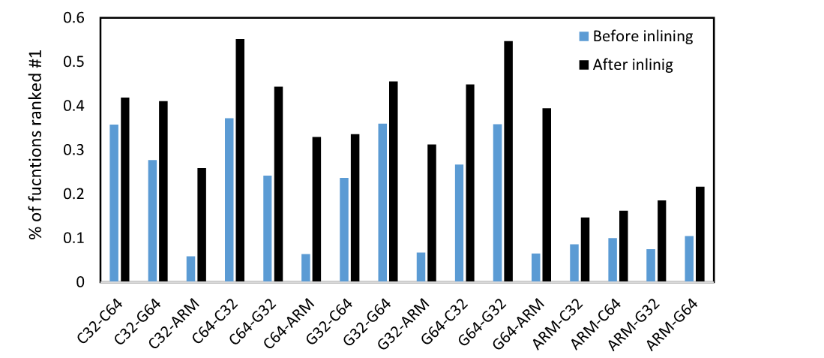
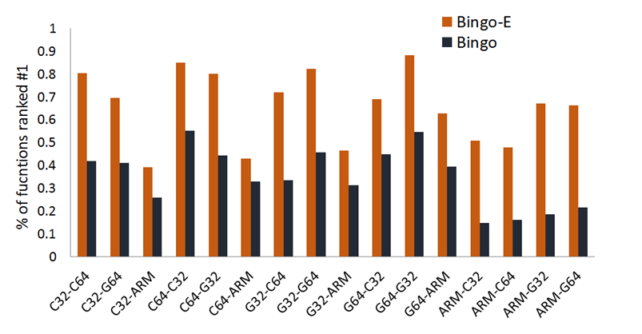
Evaluation (1)
1. Cross-architecture matching on coreutils
Bingo
Bingo-E

Slide 24
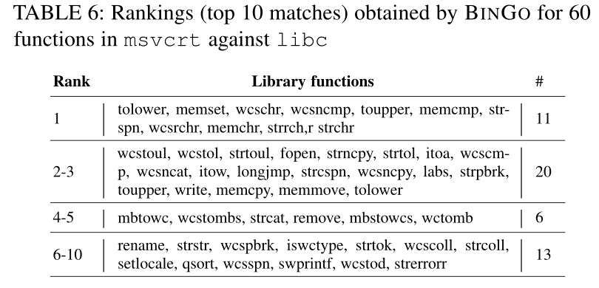
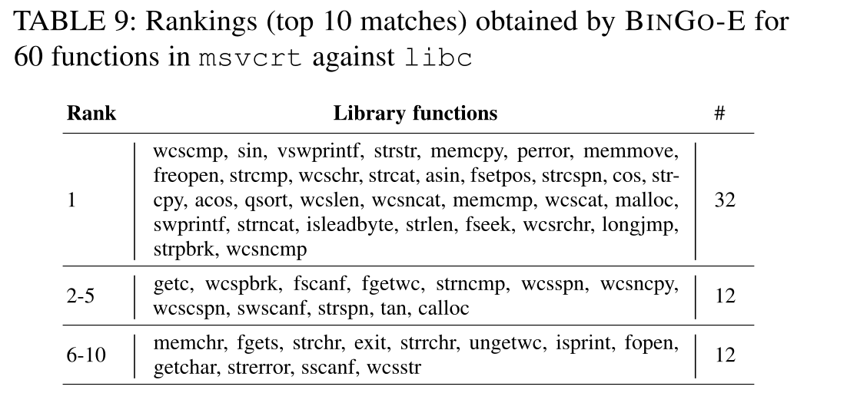
Evaluation (2)
1. Cross-OS matching on coreutils
Bingo
Bingo-E

Slide 25
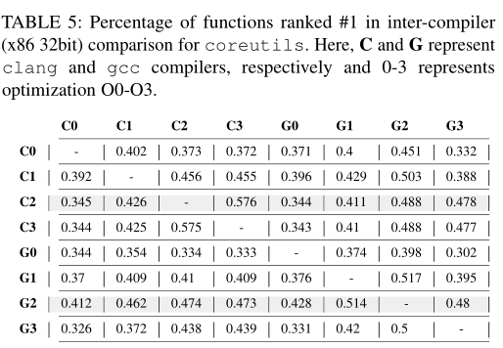
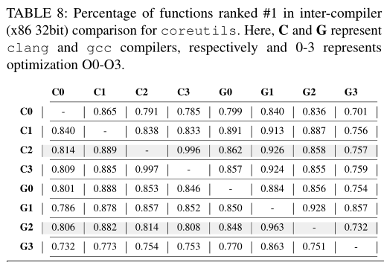
Evaluation (3)
1. Cross-Compiler matching on coreutils
Bingo
Bingo-E

Slide 26
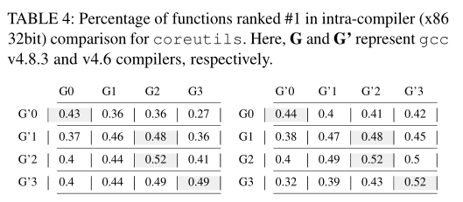
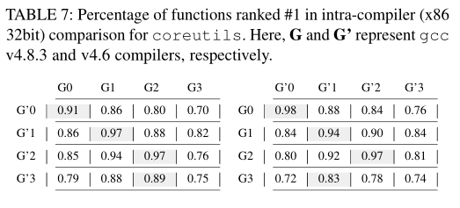
Evaluation (4)
1. Intra-Compiler matching on coreutils
Bingo
Bingo-E

Slide 27
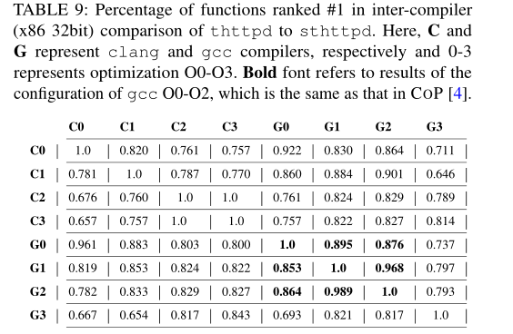
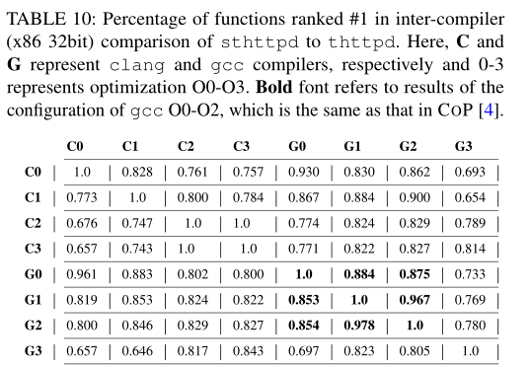
Evaluation (5)
New Application on forked projects: matching between thttpd-2.25b and sthttpd-2.26.4
Bingo-E
Bingo-E

Slide 28
Scalability and Results
1 million function matching can be done in 35 seconds without any parallelization.
Fast emulation: took 0.5 second to emulate a function with 193 basic-blocks
Matching accuracy in improved by more than 30% compare to our precious work.

Slide 29
Q&A
THANK YOU! ☺
Feedback and Suggestions?

